Slide 1
Lecture 11 Part 2 Back Propagation
Abrar Hasan
Lecturer
Dept. of Software Engineering

Slide 2
1
Back Propagation
<
T
1
>

Slide 3
Back Propagation
<
T
1
>
Remember Gradient Descent?
Gradient descent is an optimization algorithm commonly used to train machine learning models and neural networks.

Slide 4


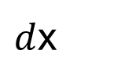

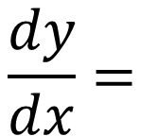
Chain Rule
<
T
1
>
$$\frac{dy}{dx}=$$
$$dy$$
$$da$$
$$da$$
$d$x

Slide 5
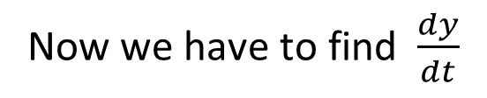
Chain Rule
<
T
1
>
y = 5x + 3
x = t²
Now we have to find $\frac{dy}{dt}$

Slide 6
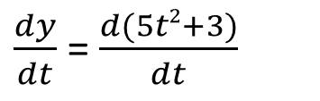
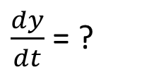
Chain Rule
<
T
1
>
y = 5x + 3
What generally we do,
x = t²
$\frac{dy}{dt}$ = ?
y = 5x + 3
= 5(t²)+3
= 5t²+3
$\frac{dy}{dt}$ = $\frac{d(5t2+3)}{dt}$
=10t

Slide 7
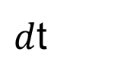
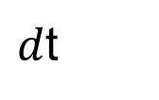
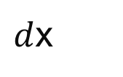
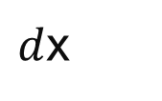

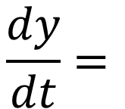

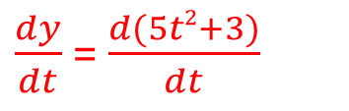




Chain Rule
<
T
1
>
y = 5x + 3
But in chain rule we see
x = t²
Y is function of X
X is a function of T
$\frac{dy}{dt}$ = ?
Instead of doing this
$$\frac{dy}{dt}=$$
$$dy$$
$d$x
$\frac{dy}{dt}$ = $\frac{d(5t2+3)}{dt}$
$d$x
$d$t
$$d$$
$$d$$
$$=$$
$$\left(5x+3\right)$$
*
(t²)
$d$x
$d$t
=5 *2t = 10t

Slide 8
<
T
1
>
W1
W7
W10
y₁
W2
W11
W8
W12
D Dimensional Input
W3
W4
W9
W5
W5
W6
W13
Total Error = $\frac{1}{2}$(T₁-outy₁)² + $\frac{1}{2}$(T₂-outy₂)²+ $\frac{1}{2}$(T₃-outy₃)²
Outy₁= activation(w₁₀x₁+ w₁₁x₂)

Slide 9
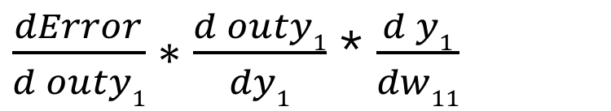
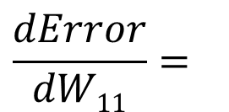
<
T
1
>
$$\frac{dError}{dW11}=$$
$\frac{dError}{d outy1}∗\frac{d outy1}{dy1}$ * $\frac{d y1}{dw11}$

Slide 10
<
T
1
>
w₁
w₅
X₁
H₁
y₁
w₂
w₆
w₃
w₇
X₂
H₂
y₂
w₄
w₈

Slide 11
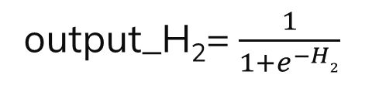

<
T
1
>
w₁
w₅
X₁
H₁
y₁
w₂
w₆
w₃
w₇
X₂
H₂
y₂
w₄
w₈
H₁= x₁*w₁ + x₂*w₂ +b₁
H₂= x₁*w₃ + x₂*w₄ +b₂
output_H₁= $\frac{1}{1+e^{−H1}}$
output_H₂= $\frac{1}{1+e^{−H2}}$

Slide 12


<
T
1
>
w₁
w₅
X₁
H₁
y₁
w₂
w₆
w₃
w₇
X₂
H₂
y₂
w₄
w₈
y₁= out_H₁*w₅ + out_H₂*w₆ +b₃
y₁= outH₁*w₇ + outH₂*w₈ +b₄
output_y₁= $\frac{1}{1+e^{−y1}}$
output_y₁= $\frac{1}{1+e^{−y1}}$

Slide 13
<
T
1
>
What we just learnt is called forward pass
Now Lets see a mathematical example

Slide 14
<
T
1
>
w₁=.15
w₅=.40
T₁=.01
T₂=.99
X₁
H₁
y₁
w₂=0.2
w₆=0.45
W₃ =.25
W₇ =.50
X₂
H₂
y₂
w₄ = 0.3
w₈ = 0.55
X₁=.05
X₂=.01
b₁ = b₂= .35
b₃ = b₄= .60

Slide 15

<
T
1
>
w₁=.15
w₅=.40
T₁=.01
T₂=.99
.05
H₁
y₁
w₂=0.2
w₆=0.45
W₃ =.25
W₇ =.50
.1
H₂
y₂
w₄ = 0.3
w₈ = 0.55
H₁= x₁*w₁ + x₂*w₂ +b₁
output_H₁= $\frac{1}{1+e^{−H1}}$
H₁= .05*.15 + .1*.2 +.35
= .5932
= .3775

Slide 16
<
T
1
>
w₁=.15
w₅=.40
T₁=.01
T₂=.99
.05
H₁
y₁
w₂=0.2
w₆=0.45
W₃ =.25
W₇ =.50
.1
H₂
y₂
w₄ = 0.3
w₈ = 0.55
H₂= .3925
output_H₂= .59688

Slide 17

<
T
1
>
w₁=.15
w₅=.40
T₁=.01
T₂=.99
.05
H₁
y₁
w₂=0.2
w₆=0.45
W₃ =.25
W₇ =.50
.1
H₂
y₂
w₄ = 0.3
w₈ = 0.55
y₁= out_H₁*w₅ + out_H₂*w₆ +b₃
output_y₁= $\frac{1}{1+e^{−y1}}$
= .5932 *.4 + .59688 *.45 +.6
= .7513
= 1.1056

Slide 18
<
T
1
>
w₁=.15
w₅=.40
T₁=.01
T₂=.99
.05
H₁
y₁
w₂=0.2
w₆=0.45
W₃ =.25
W₇ =.50
.1
H₂
y₂
w₄ = 0.3
w₈ = 0.55
y2 = 1.22
output_y₁ = .77

Slide 19
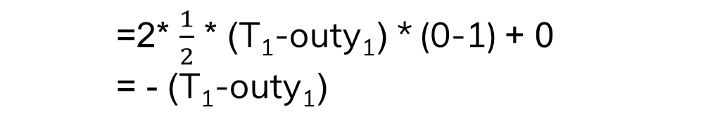
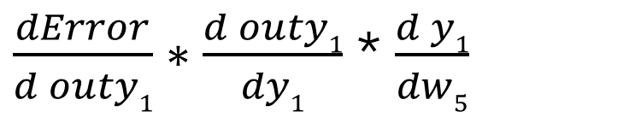

<
T
1
>
Total Error = $\frac{1}{2}$(T₁-outy₁)² + $\frac{1}{2}$(T₂-outy₂)²
$$\frac{dError}{dW5}=$$
$\frac{dError}{d outy1}∗\frac{d outy1}{dy1}$ * $\frac{d y1}{dw5}$
$\frac{dError}{d outy1}$ = $\frac{d}{d outy1}$($\frac{1}{2}$(T₁-outy₁)² + $\frac{1}{2}$(T₂-outy₂)²)
=2* $\frac{1}{2}$ * (T₁-outy₁) * (0-1) + 0
= - (T₁-outy₁)

Slide 20

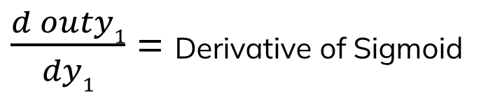
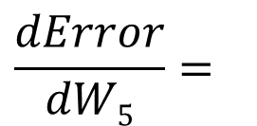
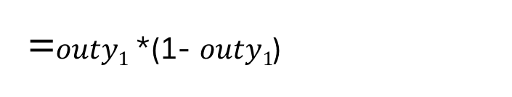
<
T
1
>
Total Error = $\frac{1}{2}$(T₁-outy₁)² + $\frac{1}{2}$(T₂-outy₂)²
$$\frac{dError}{dW5}=$$
$\frac{dError}{d outy1}∗\frac{d outy1}{dy1}$ * $\frac{d y1}{dw5}$
Derivative of Sigmoid
$\frac{d outy1}{dy1}$ = Derivative of Sigmoid
$\frac{d\text{σ}(x)}{dy1}$ = $\text{σ}\left(x\right)∗(1−\text{σ}(x)$)
=$outy1$ *(1- $outy1$)

Slide 21
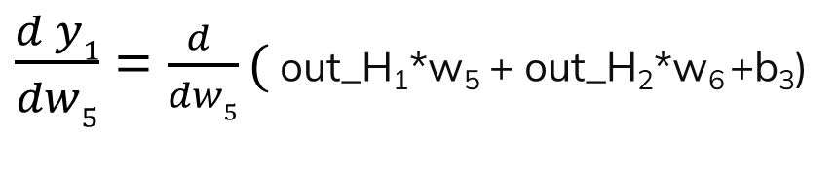
<
T
1
>
Total Error = $\frac{1}{2}$(T₁-outy₁)² + $\frac{1}{2}$(T₂-outy₂)²
$$\frac{dError}{dW5}=$$
$\frac{dError}{d outy1}∗\frac{d outy1}{dy1}$ * $\frac{d y1}{dw5}$
$\frac{d y1}{dw5}$ = $\frac{d }{dw5}($ out_H₁*w₅ + out_H₂*w₆ +b₃)
= out_H₁+ 0+0
= out_H₁

Slide 22



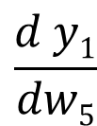


<
T
1
>
Total Error = $\frac{1}{2}$(T₁-outy₁)² + $\frac{1}{2}$(T₂-outy₂)²
$$\frac{dError}{dW5}=$$
$$\frac{dError}{d outy1}$$
$$\frac{d outy1}{dy1}$$
$$\frac{d y1}{dw5}$$
-(T₁-outy₁)
out_H₁
$$∗$$
$$∗$$
$outy1$ *(1- $outy1$)

Slide 23
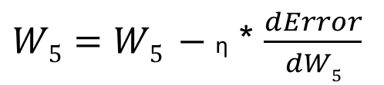
<
T
1
>
$W5=W5 −\text{η}$ * $\frac{dError}{dW5}$

Slide 24
<
T
1
>
Do the same for all weight

Slide 25
<
T
1
>
w₁=.15
w₅=.40
T₁=.01
T₂=.99
X₁
H₁
y₁
w₂=0.2
w₆=0.45
W₃ =.25
W₇ =.50
X₂
H₂
y₂
w₄ = 0.3
w₈ = 0.55

Slide 26
<
T
1
>
w₁=.15
w₅=.40
T₁=.01
T₂=.99
X₁
H₁
y₁
w₂=0.2
w₆=0.45
W₃ =.25
W₇ =.50
X₂
H₂
y₂
w₄ = 0.3
w₈ = 0.55

Slide 27
<
T
1
>
w₁=.15
w₅=.40
T₁=.01
T₂=.99
X₁
H₁
y₁
w₂=0.2
w₆=0.45
W₃ =.25
W₇ =.50
X₂
H₂
y₂
w₄ = 0.3
w₈ = 0.55

Slide 28
<
T
1
>
w₁=.15
w₅=.40
T₁=.01
T₂=.99
X₁
H₁
y₁
w₂=0.2
w₆=0.45
W₃ =.25
W₇ =.50
X₂
H₂
y₂
w₄ = 0.3
w₈ = 0.55

Slide 29
Thank You

